Slide 1
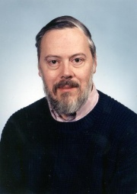
Overview
Sean Colgan, Eoghan Byrne, Niall Dowd & Tom Hemeryck

Slide 2
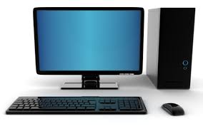
What is a Computer?
Computers are machines that perform tasks or calculations according to a set of instructions, or programs. The first fully electronic computers, introduced in the 1940s, were huge machines that required teams of people to operate. Compared to those early machines, today's computers are amazing. Not only are they thousands of times faster, they can fit on your desk, on your lap, or even in your pocket.
A Computer is an electronic device which is capable of receiving information or data in a particular form and performing a sequence of operations in accordance with a program to produce a result in the form of information or signals.
Sources: http://en.wikipedia.org/wiki/Computer
Sources: http://windows.microsoft.com/en-ie/windows/introduction-to-computers#1TC=windows-7
Notes:
references go here:

Slide 3
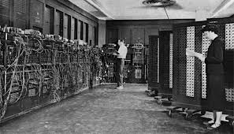
History of Computers
The first substantial computer was the giant ENIAC machine by John W. Mauchly and J. Presper Eckert at the University of Pennsylvania. ENIAC used a word of 10 decimal digits instead of binary ones like previous automated calculators/computers. ENIAC was also the first machine to use more than 2,000 vacuum tubes, using nearly 18,000 vacuum tubes. Storage of all those vacuum tubes and the machinery required to keep the cool took up over 167 square meters (1800 square feet) of floor space. Nonetheless, it had punched-card input and output and arithmetically had 1 multiplier, 1 divider-square rooter, and 20 adders employing decimal "ring counters," which served as adders and also as quick-access read-write register storage.
Sources: http://homepage.cs.uri.edu/faculty/wolfe/book/Readings/Reading03.htm
Notes:
references go here:

Slide 4
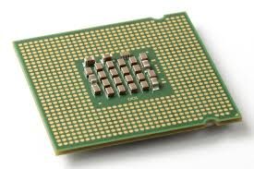
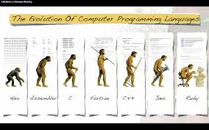
What is a Computer Program?
:a pc program is a set of instructions that works with the pc to complete tasks and is written by programmers.
:a program is stored in a place place called central processor
:programs are written in a programing language in imperative or declarative
:computers can't work without a program because it has no instructions to react
with comands
Notes:
references go here:

Slide 5
History of Programming
The first computer programming started taking place around the 1940’s, to communicate instructions to computers.
In 1949, Von Neumann’s work was huge step forward in the formation of Short Code, which required the workers to change the code into 1’s and 0’s.
In 1957 one of the main languages FORTRAN was formed. The components were very simple allowing programmers easy access to the computer's innards.
COBOL was developed to make up for FORTRAN’s inability to handle input and output for Business Computing.
LISP was created for a specialist field, controlling Artificial Intelligence (AI). It remains in use today because of it’s highly specialised manipulative nature.
The Algol language which was created by a committee for scientific use, led to the development of languages such as Pascal, C, C++ and Java.
Sources:http://cs.brown.edu/~adf/programming_languages.html
Notes:
references go here:

Slide 6
Who Developed C
C was originally developed by Dennis Ritchie between 1969 and 1973 at AT&T Bell Labs, and used to reimplement the Unix operating system.
It has since become one of the most widely used programming languages of all time.
C has been standardized by the American National Standards Institute (ANSI) since 1989 and subsequently by the International Organization for Standardization (ISO).
Many other languages have borrowed directly or indirectly from C, including C#, C++, Objective-C, D, Java, JavaScript, PHP, Python and Unix's C shell.
These languages have drawn many of their control structures and other basic features from C, usually with overall syntactical similarity to C.
It is also used as an intermediate language for other languages, and for building standard libraries and runtime systems for higher-level languages, such as CPython.
Source; Wikipedia.org
Notes:
references go here:

Slide 7
Where is C used?
C itself is only used on low level systems but the growth from C is being used in daily situations including numerous operating systems.
C is used Everywhere!
Notes:
references go here:

